Slide 1
STOCK MARKET NOTIFICATION (PUB-SUB)
Pooja Gona
Pooja Munishamappa Raju
Pujitha Kallu

Slide 2
INTRODUCTION
Stock Market Notification System :
The Pub/Sub model is a messaging pattern used in distributed systems
It enables asynchronous communication between components.
Key players: Publishers, Subscribers, and the central Topic [channels].

Slide 3


KEY DESIGN
Leveraging Berkeley Sockets for communication, the system employs multiple servers featuring leader election mechanisms to ensure fault tolerance.
The design aims to eliminate any single point of failure, adopting a layered architecture for robustness and scalability.

Slide 4
RELATED WORK
Our project leverages the publish-subscribe model, Docker, and modern development tools like Java, React, and Bootstrap, building on existing distributed systems' frameworks for enhanced scalability and user engagement, while integrating proven strategies for efficient, responsive application design.
Notes:
Left: RSS
Right: GossipSub

Slide 5




FEATURES
USERS HAVE THE CAPABILITY TO SUBSCRIBE TO DIFFERENT TOPICS AND RECEIVE NOTIFICATIONS WHENEVER A MESSAGE IS PUBLISHED TO THEIR CHOSEN TOPIC.
THE SYSTEM IS DESIGNED TO GRACEFULLY HANDLE VARIOUS FAILURES:
SCENARIOS WHERE A SUBSCRIBER (CLIENT) FAILS,
THE LEADER FAILS, OR A NON-LEADER COMPONENT FAILS.

Slide 6
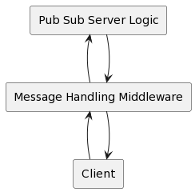
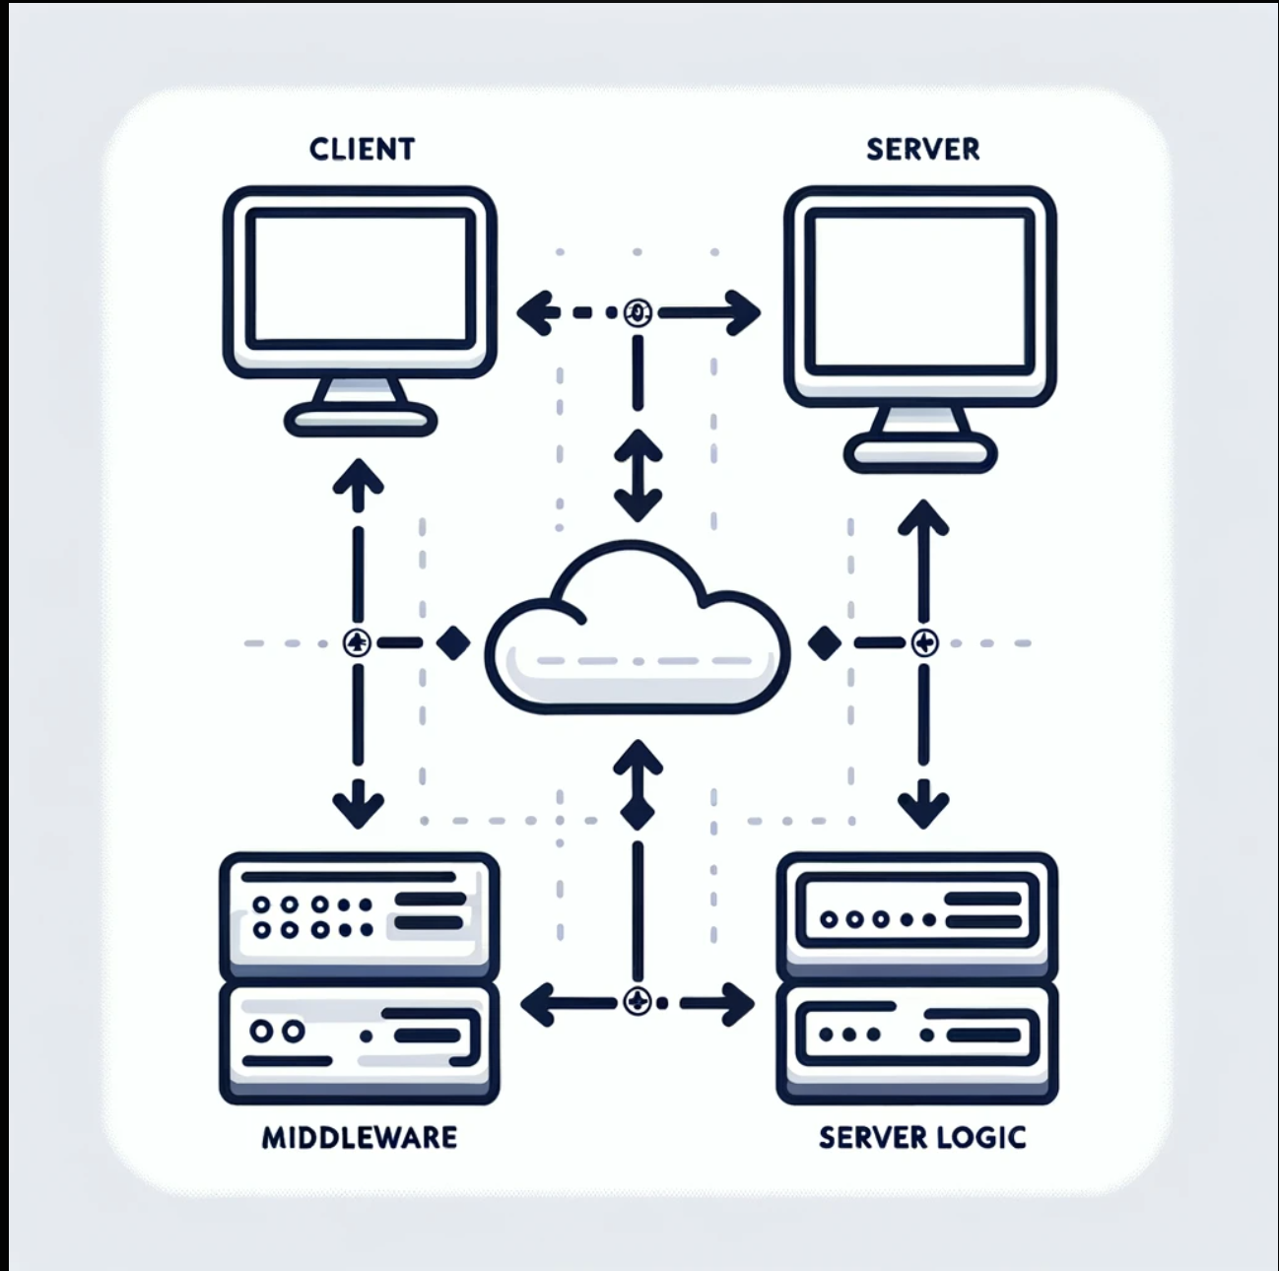
SYSTEM OVERVIEW
Component Diagram
Architecture Diagram

Slide 7



SYSTEM OVERVIEW
High-level architecture diagram depicting components
Publishers, Subscribers, and Broker
Overview of communication flow

Slide 8


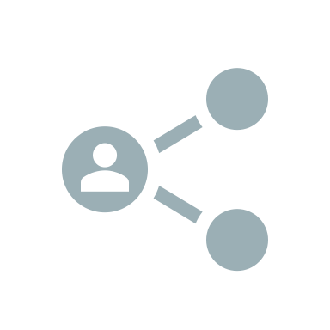
CORE COMPONENTS
Publishers: Entities generating and publishing messages
Subscribers: Entities expressing interest in specific topics
Broker (if applicable): Intermediary facilitating message distribution

Slide 9
DEMO

Slide 10
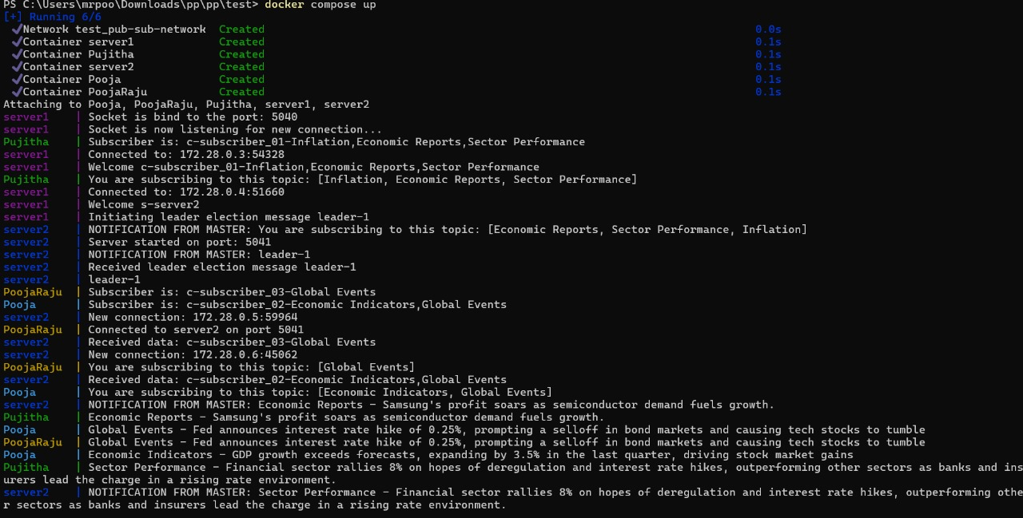
Success Flow

Slide 11
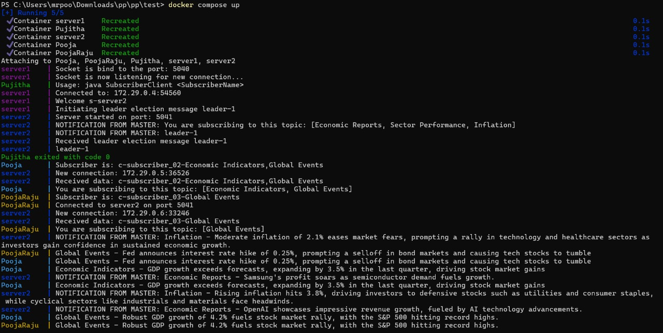
HANDLING FAILURES
Subscriber Disconnect

Slide 12
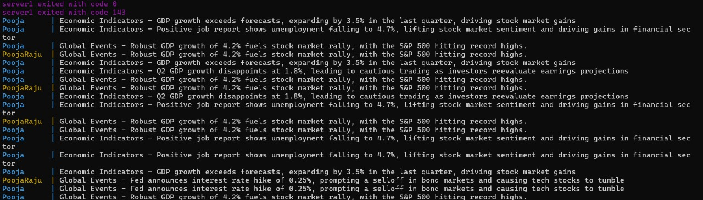
HANDLING FAILURES
Leader Failure

Slide 13
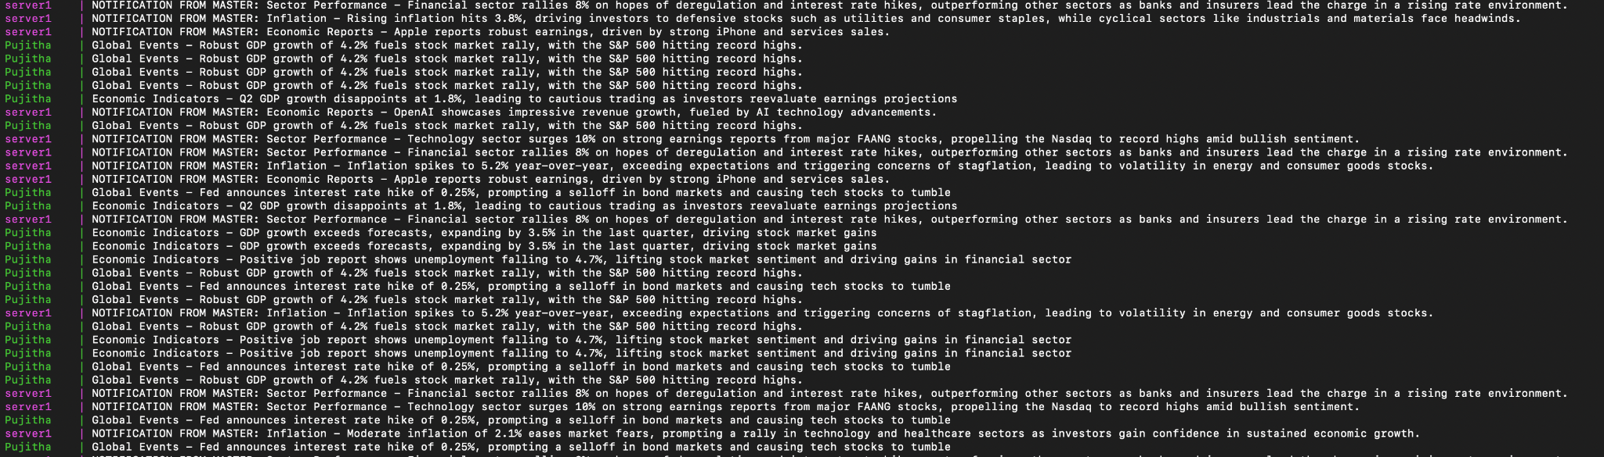
HANDLING FAILURES
Non-Leader Failure

Slide 14
ANALYSIS RESULTS
Growth rate is O(N) as expected
Leader server has the capability to manage approximately 110,000 events per second, whereas the non-leader server can handle around 90,000 events.
The test outcomes affirm that the Stock Market Notification Pub-Sub Distributed System delivered strong performance across diverse scenarios, meeting the predefined criteria for functionality, resilience, and scalability.
Subscriber Connection and Subscription
Leader Election and Governance
Event Generation and Notification
Subscriber Disconnection and Reconnection
High Load Throughput and Latency

Slide 15
DESIGN IMPACT
1. Decoupling: Enhances modularity and flexibility by allowing independent development and scaling of components.
9. Topics and Subscriptions: Necessitates a design for efficient topic management and subscription handling, allowing for categorization and customization.
2. Scalability: Influences architecture to handle increasing Publishers and Subscribers, emphasizing distributed systems and efficient resource utilization.
8. Dynamic Component Management: Requires interfaces for dynamic addition/removal of components, ensuring adaptability without disruption.
3. Flexibility in Subscriptions: Requires a design that accommodates dynamic user preferences, allowing Subscribers to customize topic subscriptions.
4. Communication Workflow: Focuses on efficient and reliable message transmission, involving considerations for asynchronous communication and delivery mechanisms.
7. Use of Berkeley Sockets: Impacts the communication layer, requiring considerations for socket management, protocol design, and error handling.
6. Reliability and Redundancy: Involves designing reliable message queues, acknowledgment systems, and error-handling mechanisms for consistent message delivery.
5. Failure Handling: Requires fault-tolerant mechanisms, redundancy, and graceful degradation strategies to ensure system resilience.

Slide 16
FUTURE WORK
Replication enhances error handling with increased gracefulness and speed.
Transitioning from Berkeley sockets to the Web-Sockets standard enables clients to be web-based using JavaScript Websockets libraries.
The implementation of a load balancer ensures even distribution of clients across servers, preventing server overload and facilitating horizontal scalability.
To broaden system capabilities, integration with multimedia is pursued, extending support beyond text updates.

Slide 17



CONCLUSION
Pub sub news that allows users to subscribe to topics and publishers to publish to topics
Leader election and failure handling with a layered architecture
In the future we would like to add replication, move from Berkeley sockets to websockets, add load balancing, and support for multimedia

